Slide 1
CHAPTER 3
DECISION TREE LEARNING

Slide 2
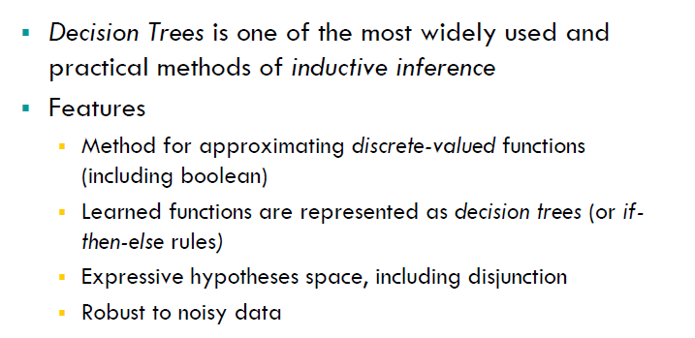
INDUCTIVE INFERENCE WITH DECISION TREES

Slide 3
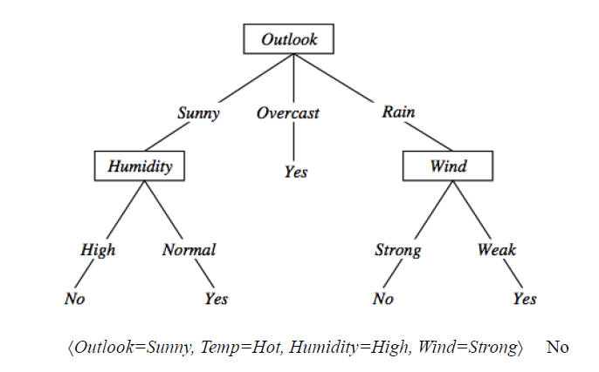
DECISION TREE REPRESENTATION, PLAY TENNIS

Slide 4
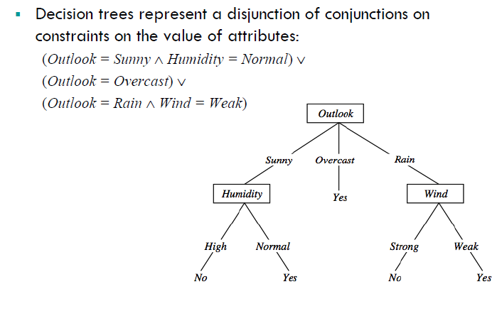
DECISION TREE EXPRESSIVITY

Slide 5
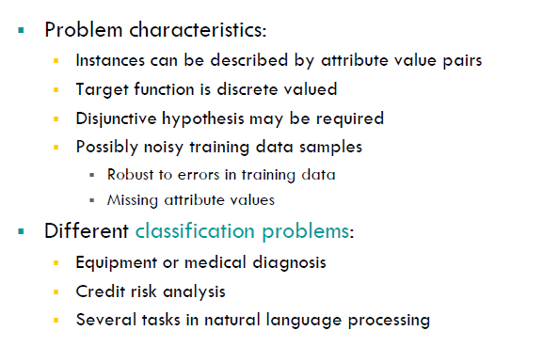
APPROPRIATE PROBLEMS FOR DECISION TREE LEARNING

Slide 6
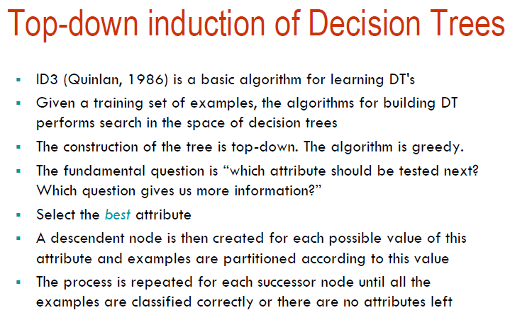
THE BASIC DECISION TREE LEARNING ALGORITHM

Slide 7
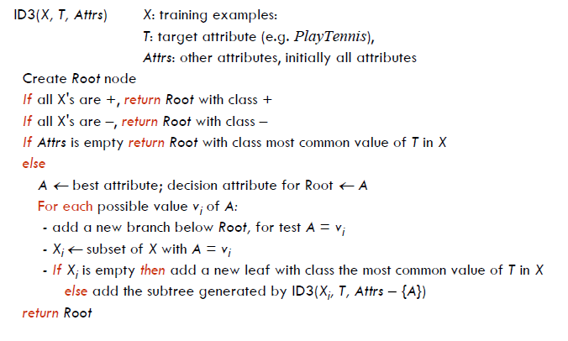
ID3 ALGORITHM

Slide 8
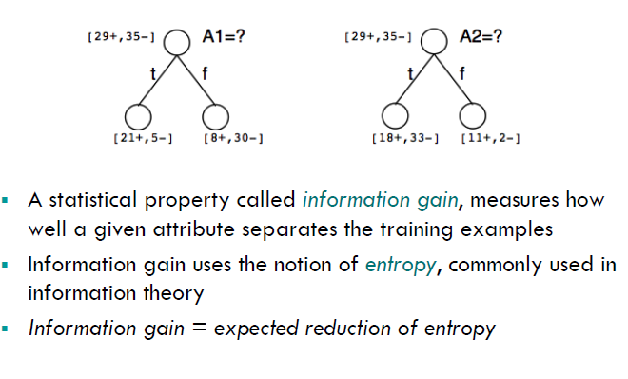
WHICH ATTRIBUTE IS THE BEST CLASSIFIER

Slide 9
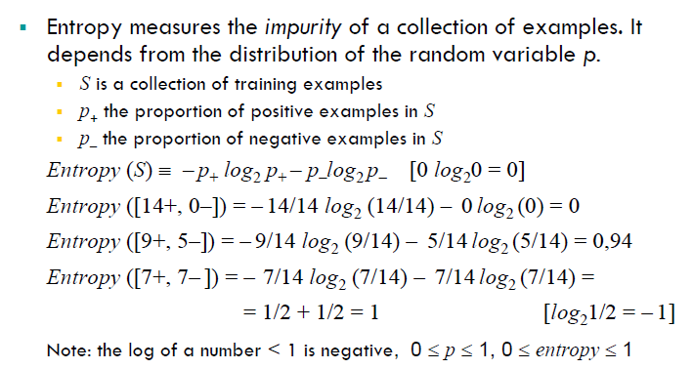
ENTROPY IN BINARY CLASSIFICATION

Slide 10
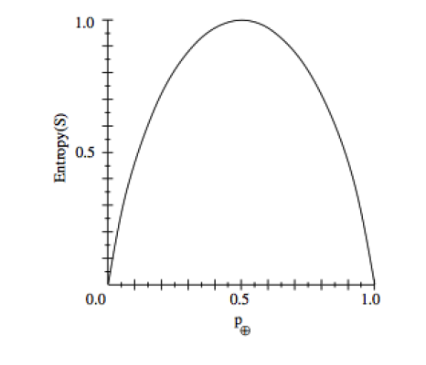
ENTROPY

Slide 11
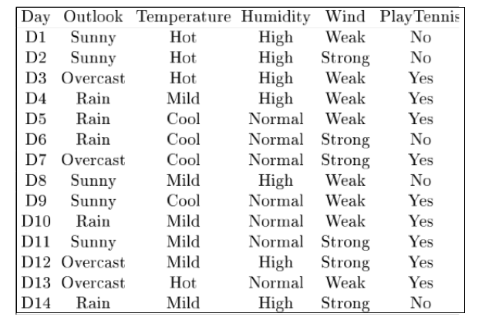
EXAMPLE

Slide 12
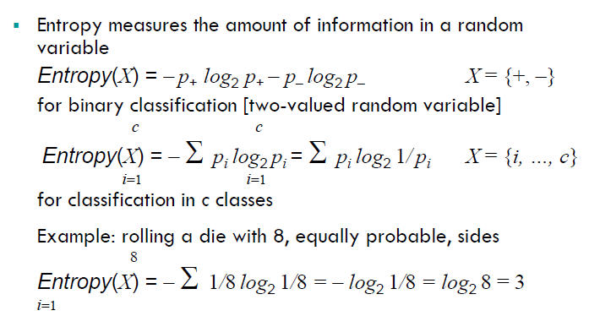
ENTROPY IN GENERAL

Slide 13
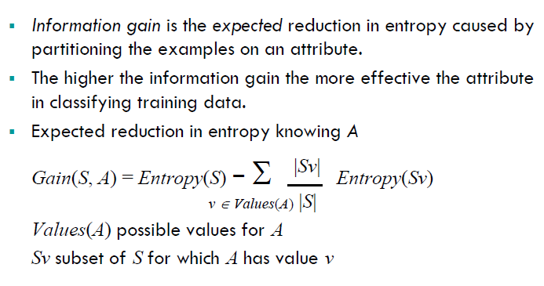
INFORMATION FAIN AS ENTROPY REDUCTION

Slide 14
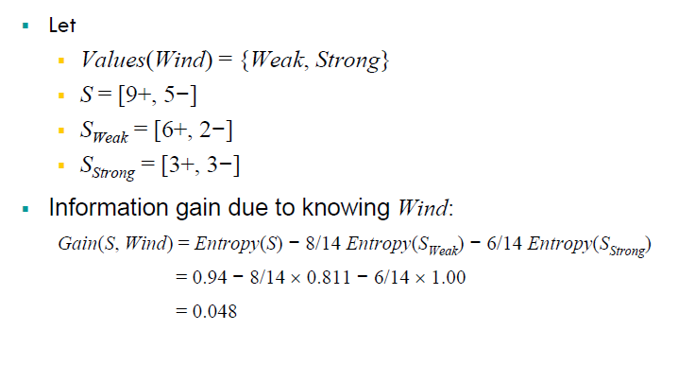
EX: EXPECTED INFORMATION GAIN

Slide 15
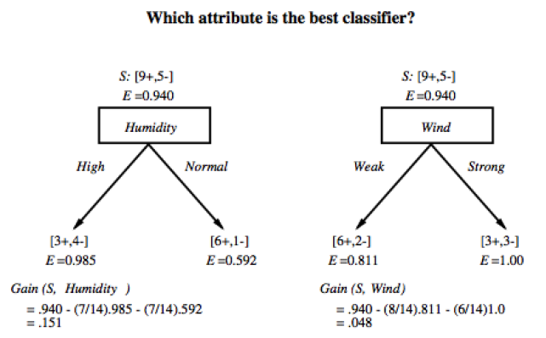
BEST CLASSIFIER- ATTRIBUTE

Slide 16
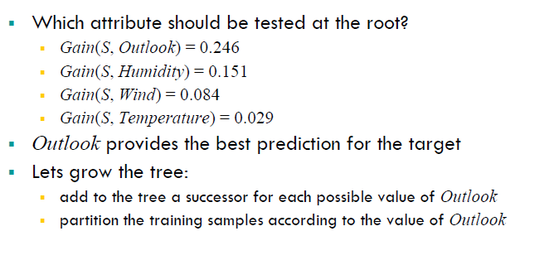
WHICH ATTRIBUTE TO TEST AT ROOT:FIRST STEP

Slide 17
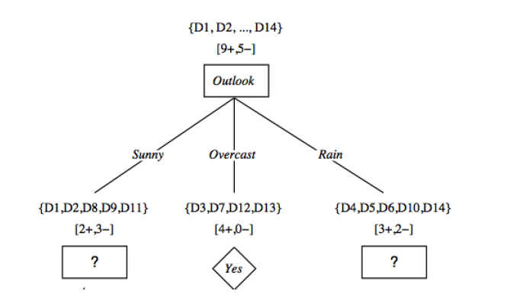
AFTER FIRST STEP

Slide 18
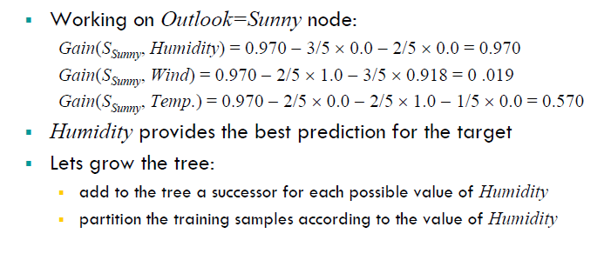
SECOND STEP

Slide 19
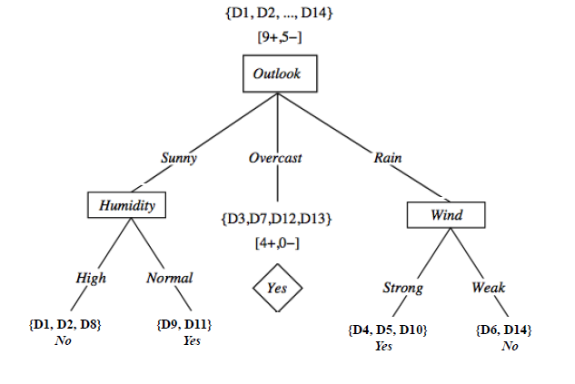
SECOND & THIRD STEPS

Slide 20
ID3 ALGORITHM

Slide 21
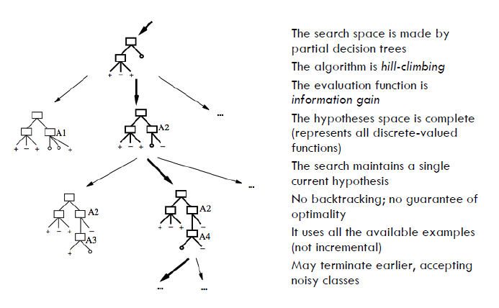
SEARCH SPACE IN DTL

Slide 22
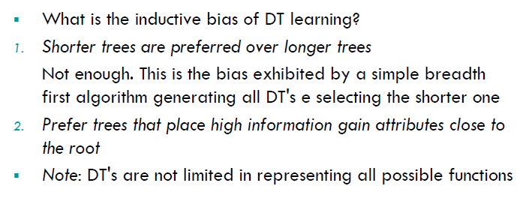
INDUCTIVE BIAS IN DTL

Slide 23
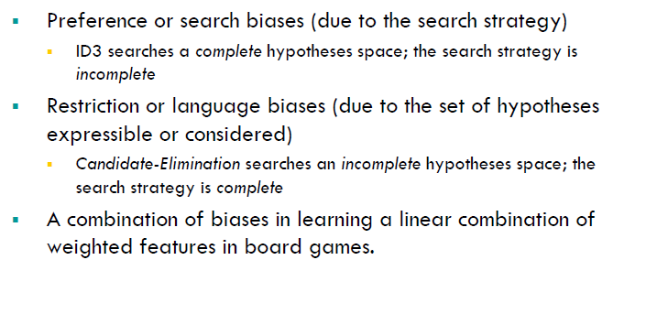
2 KINDS OF BIASES

Slide 24
ID3 SEARCH VS CANDIDATE ELIMINATION ALGORITHM
PARAMETER/FEATURE | ID3 SEARCH | CANDIDATE ELIMINATION
HYPOTHESIS SPACE | COMPLETE | INCOMPLETE
SEARCH | INCOMPLETE | COMPLETE
HYPOTHESIS | SIMPLE TO COMPLEX | EVERY CONSISTENT HYPOTHESIS
INDUCTIVE BIAS | HYPOTHESIS BY SEARCH STRATEGY | EXPRESSIVE POWER OF HYPOTHESIS REPRESENTATION
ADDITIONAL BIAS | YES | NO
INDUCTIVEBIAS FOLLOWS | SEARCH STRATEGY | SEARCH SPACE
DEFINITION | Bias of ID3 is preference for certain hypothesis over others. Hence it is called preference bias or search bias | It is a kind of categorical restriction type of bias on the set of hypothesis considered. Thus it is called restriction bias or language bias
DESIRABLE | MORE | LESS

Slide 25
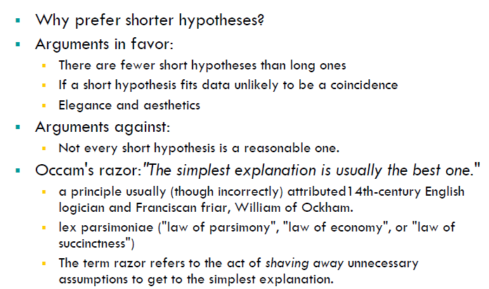
PREFER SHORTER HYPOTHESIS

Slide 26
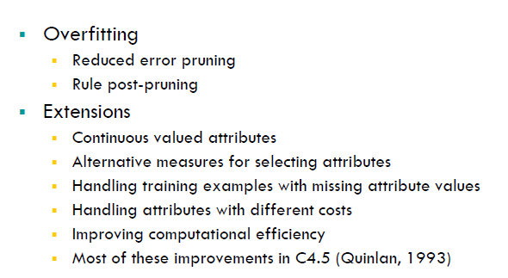
ISSUES IN DTL

Slide 27
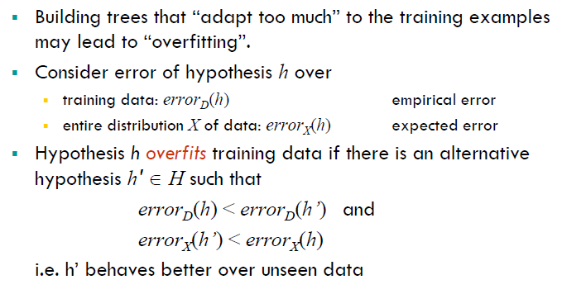
OVERFITTING DEFINITION

Slide 28
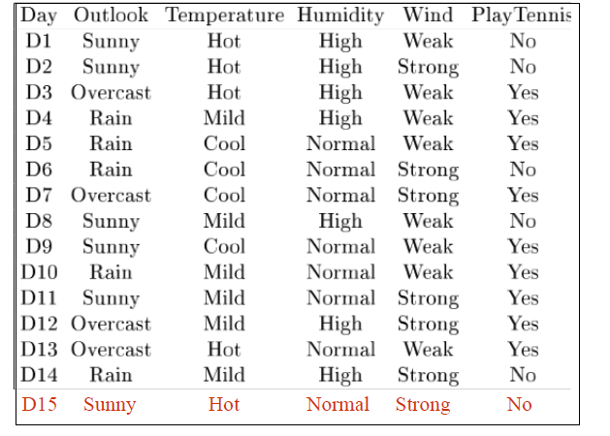
EXAMPLE

Slide 29
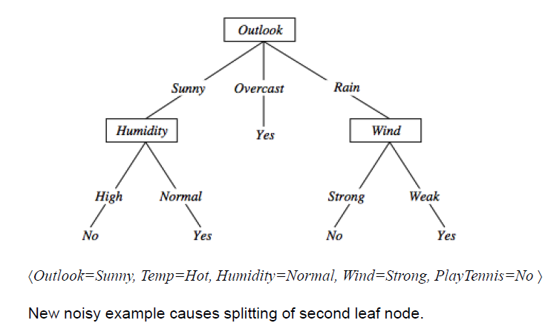
OVERFITTING IN DECISION TREES

Slide 30
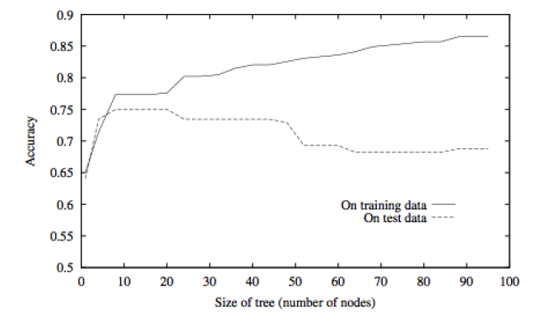
OVERFITTING IN DECISION TREES

Slide 31
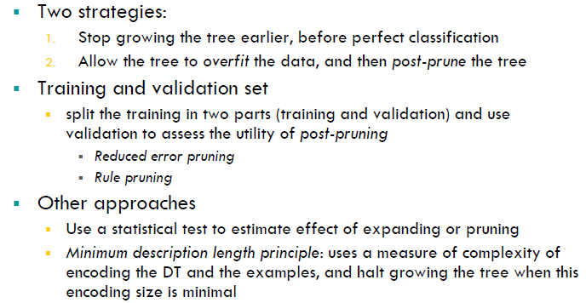
AVOID OVER FITTING IN DECISION TREES

Slide 32
Issues in decision trees learning
Overfitting
Reduced error pruning
Rule post-pruning
Extensions
Continuous valued attributes
Alternative measures for selecting attributes
Handling training examples with missing attribute values
Handling attributes with different costs
Improving computational efficiency
Most of these improvements in C4.5 (Quinlan, 1993)

Slide 33
Overfitting: definition
Building trees that “adapt too much” to the training examples may lead to “overfitting”.
Consider error of hypothesis h over
training data: error_{D}(h)
entire distribution X of data: error_{X}(h)
empirical error expected error
Hypothesis h overfits training data if there is an alternative hypothesis h' ∈ H such that
error_{D}(h) < error_{D}(h’) and
error_{X}(h’) < error_{X}(h)
i.e. h’ behaves better over unseen data

Slide 34
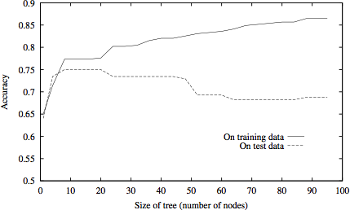
Overfitting in decision tree learning

Slide 35
Avoid overfitting in Decision Trees
Two strategies:
Stop growing the tree earlier, before perfect classification
Allow the tree to overfit the data, and then post-prune the tree
Training and validation set
split the training in two parts (training and validation) and use validation to assess the utility of post-pruning
Reduced error pruning
Rule pruning
Other approaches
Use a statistical test to estimate effect of expanding or pruning
Minimum description length principle: uses a measure of complexity of encoding the DT and the examples, and halt growing the tree when this encoding size is minimal

Slide 36
Reduced-error pruning (Quinlan 1987)
Each node is a candidate for pruning
Pruning consists in removing a subtree rooted in a node: the node becomes a leaf and is assigned the most common classification
Nodes are removed only if the resulting tree performs no worse on the validation set.
Nodes are pruned iteratively: at each iteration the node whose removal most increases accuracy on the validation set is pruned.
Pruning stops when no pruning increases accuracy

Slide 37
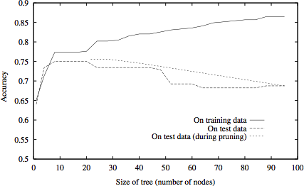
Effect of reduced error pruning

Slide 38
Rule post-pruning
Create the decision tree from the training set
Convert the tree into an equivalent set of rules
Each path corresponds to a rule
Each node along a path corresponds to a pre-condition
Each leaf classification to the post-condition
Prune (generalize) each rule by removing those preconditions whose removal improves accuracy …
… over validation set
… over training with a pessimistic, statistically inspired, measure
Sort the rules in estimated order of accuracy, and consider them in sequence when classifying new instances

Slide 39
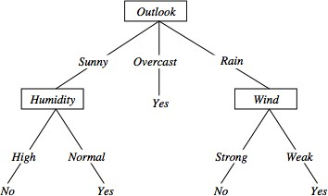
Converting to rules
(Outlook=Sunny)∧(Humidity=High) ⇒ (PlayTennis=No)

Slide 40
Why converting to rules?
Each distinct path produces a different rule: a condition removal may be based on a local (contextual) criterion. Node pruning is global and affects all the rules
In rule form, tests are not ordered and there is no book- keeping involved when conditions (nodes) are removed
Converting to rules improves readability for humans

Slide 41
Dealing with continuous-valued attributes
So far discrete values for attributes and for outcome.
Given a continuous-valued attribute A, dynamically create a new attribute A_{c}
A_{c} = True if A < c, False otherwise
How to determine threshold value c ?
Example. Temperature in the PlayTennis example
Sort the examples according to Temperature
Temperature | 40 | 48 | | | 60 | 72 | 80 | | 90
PlayTennis | No | No | 54 | Yes | Yes | Yes | 85 No
Determine candidate thresholds by averaging consecutive values where there is a change in classification: (48+60)/2=54 and (80+90)/2=85
Evaluate candidate thresholds (attributes) according to information gain. The best is Temperature_{>54}.The new attribute competes with the other ones

Slide 42
Problems with information gain
Natural bias of information gain: it favours attributes with many possible values.
Consider the attribute Date in the PlayTennis example.
Date would have the highest information gain since it perfectly separates the training data.
It would be selected at the root resulting in a very broad tree
Very good on the training, this tree would perform poorly in predicting unknown instances. Overfitting.
The problem is that the partition is too specific, too many small classes are generated.
We need to look at alternative measures …

Slide 43
An alternative measure: gain ratio
i=1 |S | |S |
S_{i} are the sets obtained by partitioning on value i of A
SplitInformation measures the entropy of S with respect to the values of A. The more uniformly dispersed the data the higher it is.
Gain(S, A)
GainRatio(S, A) ≡
SplitInformation(S, A)
GainRatio penalizes attributes that split examples in many small classes such as
Date. Let |S |=n, Date splits examples in n classes
SplitInformation(S, Date)= −[(1/n log₂ 1/n)+…+ (1/n log₂ 1/n)]= −log₂1/n =log₂n
Compare with A, which splits data in two even classes:
SplitInformation(S, A)= − [(1/2 log₂1/2)+ (1/2 log₂1/2) ]= − [− 1/2 −1/2]=1
c |S_{i} | |S_{i} |
SplitInformation(S, A) ≡ − Σ
log₂

Slide 44
Adjusting gain-ratio
Problem: SplitInformation(S, A) can be zero or very small when |S_{i} | ≈ |S | for some value i
To mitigate this effect, the following heuristics has been used:
compute Gain for each attribute
apply GainRatio only to attributes with Gain above average
Other measures have been proposed:
Distance-based metric [Lopez-De Mantaras, 1991] on the partitions of data
Each partition (induced by an attribute) is evaluated according to the distance to the partition that perfectly classifies the data.
The partition closest to the ideal partition is chosen

Slide 45
Handling incomplete training data
How to cope with the problem that the value of some attribute may be missing?
Example: Blood-Test-Result in a medical diagnosis problem
The strategy: use other examples to guess attribute
Assign the value that is most common among the training examples at the node
Assign a probability to each value, based on frequencies, and assign values to missing attribute, according to this probability distribution
Missing values in new instances to be classified are treated accordingly, and the most probable classification is chosen (C4.5)

Slide 46
Handling attributes with different costs
Instance attributes may have an associated cost: we would prefer decision trees that use low-cost attributes
ID3 can be modified to take into account costs:
(1990)
Gain²(S, A)
1. Tan and Schlimmer
Cost(S, A)
2. Nunez (1988)
₂Gain(S, A)
− 1
(Cost(A) + 1)^{w}
w ∈ [0,1]

